Slide 1
Movie Recommendation
Using collaborative filtering

Slide 2
Team members and guide details
CH.Harika 2451-19-737-013
K.Sai Kiran 2451-19-737-011
T.Sai Kiran 2451-19-737-049
Guide:
Dr.A.V.Krishna Prasad
Associate professor,ITD

Slide 3
Contents
Abstract
Introduction
Literature Survey
Problem Statement
Existing system
Proposed system
System requirements
Architecture
Design Phase
Implementation
Results
Conclusion
Reference

Slide 4
Abstract
Movies are one of the sources of entertainment, but the problem is in finding the desired content from the ever-increasing millions of content every year. However, recommendation systems come much handier in these situations. The aim of this project is to improve the accuracy and performance of a regular filtering technique. Although varieties of methods are used to implement a recommendation system, Content-based filtering is the simplest method. Which takes input from the users, rechecks his/her history/past behavior, and recommends a list of similar movies. In this paper, to prove the effectiveness, K-NN algorithms and collaborative filtering are used to mainly focus on enhancing the accuracy of results as compared to content-based filtering. This approach is based on cosine similarity using k-nearest neighbor with the help of a collaborative filtering technique, at the same time removing the drawbacks of the content-based filtering. Although using Euclidean distance is preferred, cosine similarity is used as the accuracy of cosine angle and the equidistance of movies remain almost the same.

Slide 5
Introduction
There are many different types of recommender systems to recommend hotels,clothing, food, songs, movies and so on. They all work on different scenarios but the main concept behind them all are same. We made movie recommender system using collaborative system.
Collaborative Filtering- This system matches persons with similar interests and provides recommendations based on this matching.
This is achieved by making a matrix of items each user has rated/viewed/liked/clicked depending upon the task at hand, and then computing the similarity score between the users and finally recommending items that the concerned user isn’t aware of butusers similar to him/her are and liked it.

Slide 6
Literature Survey
S.No | Author(s) | Problem Identified | Technology used | DrawBacks
1. | Wilkinson and Schreiber | data sparsity | a collaborative ﬁltering algorithm based on the ALS | Cold start problem
2. | Wei | cold start problem | deep learning neural network | Low scalability
3. | Kupisz and Unold | Low processing ability of large-scale data | item-based collaborative ﬁltering algorithmHadoop’s disk-based MapReduce para- digm and Spark’s in-memory based RDD paradigm | Cannot provide accurate personalized results.

Slide 7
Problem Statement
Recommendation systems are often implemented as a service applicable to every user. This study will analyze the advantages of these recommender systems and discuss whether the resources spent give a satisfactory outcome for companies. There are several machine learning algorithms that can be used for this purpose. To delimit this report, it will focus on the K nearest neighbors algorithm. KNN is one of the more intuitive algorithms for the purpose of movie rating prediction, which made it interesting to analyze its’ usefulness. A baseline method of using a movies’ mean rating as an estimate for all users’ rating predictions will be used for comparison.

Slide 8
Existing system
The most popular recommendation systems now-a-days are:
Amazon(e-commerce): It uses AI and ML algorithms for Hybrid recommendation system.
Netflix(entertainment ): It uses Content-based filtering for personalised recommendations.
Spotify: It uses Item based and User based filtering for songs recommendations
IMDB: It uses user based collaborative filtering for movies

Slide 9
Proposed system
To recommend the movies in the given range of the years by the user using
K-Nearest Neighbour algorithm for User-Based collaborative filtering.

Slide 10
System requirements
HARDWARE REQUIREMENTS: Processor: Core i3 and above Hard Disk: 256GB and above Ram: 4GB and above
SOFTWARE REQUIREMENTS: Operating System: Windows 10/11 Software: PyCharm,Python.

Slide 11
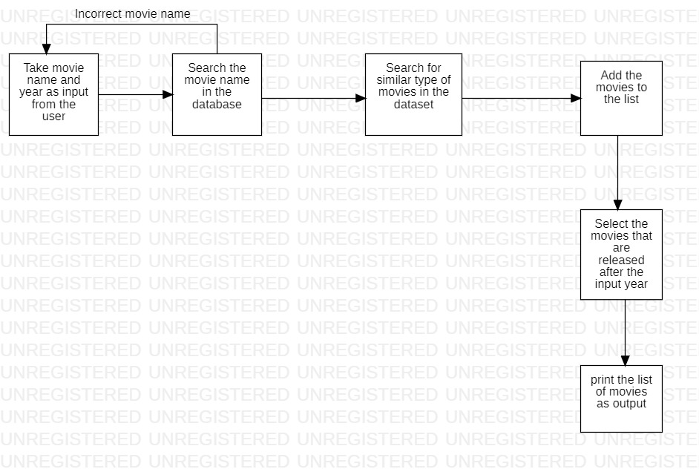
ARCHITECTURE

Slide 12
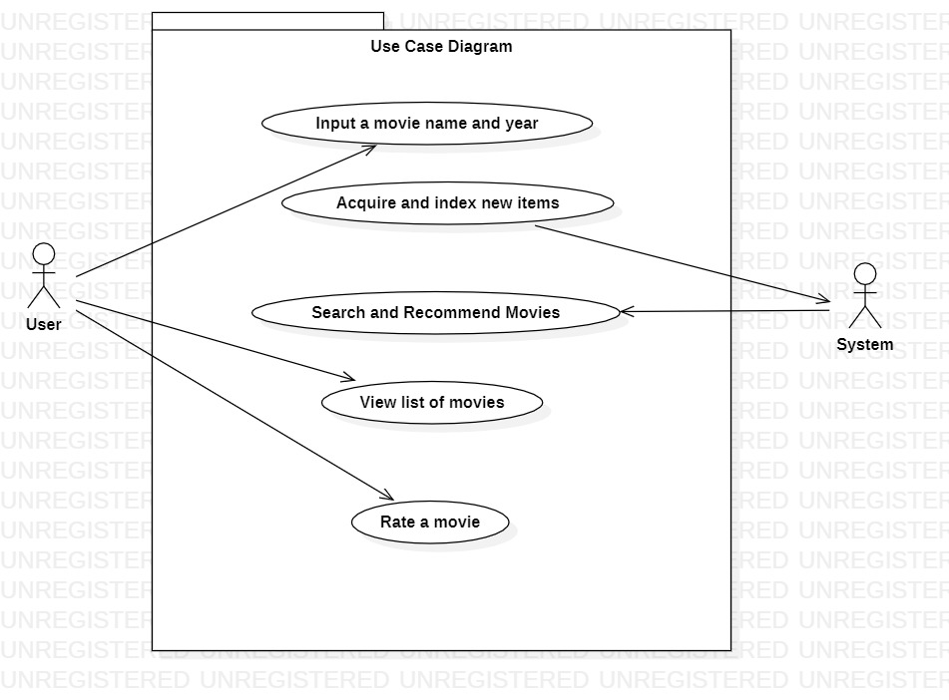
USE CASE DIAGRAM

Slide 13
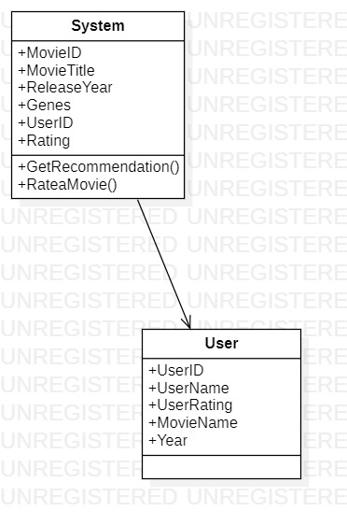
CLASS DIAGRAM

Slide 14
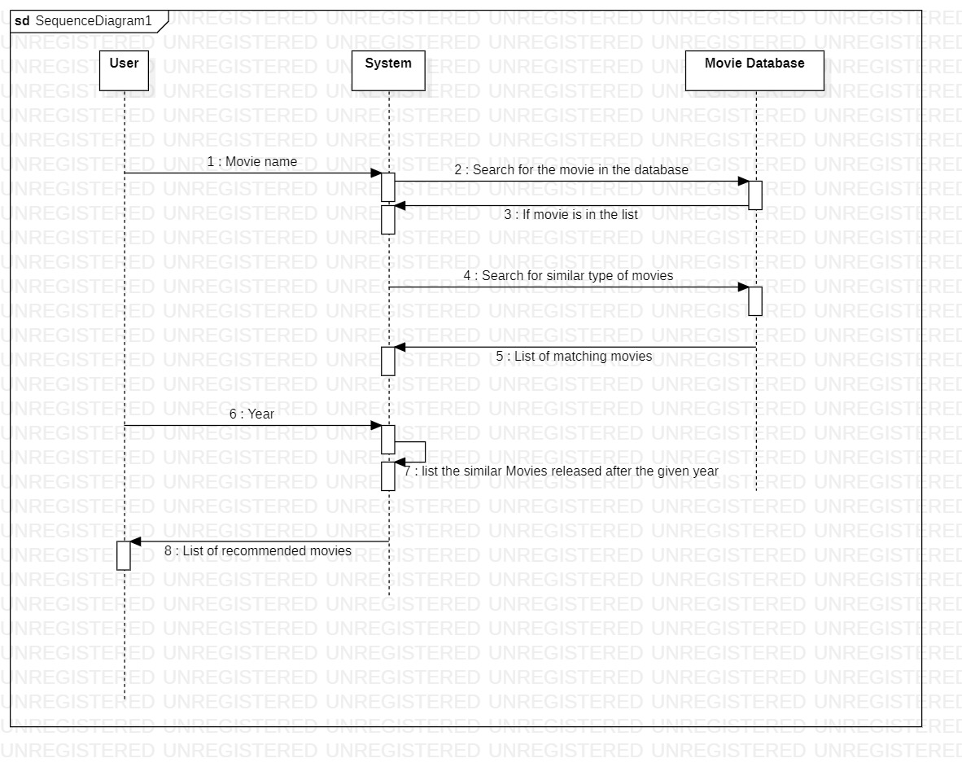
SEQUENCE DIAGRAM

Slide 15
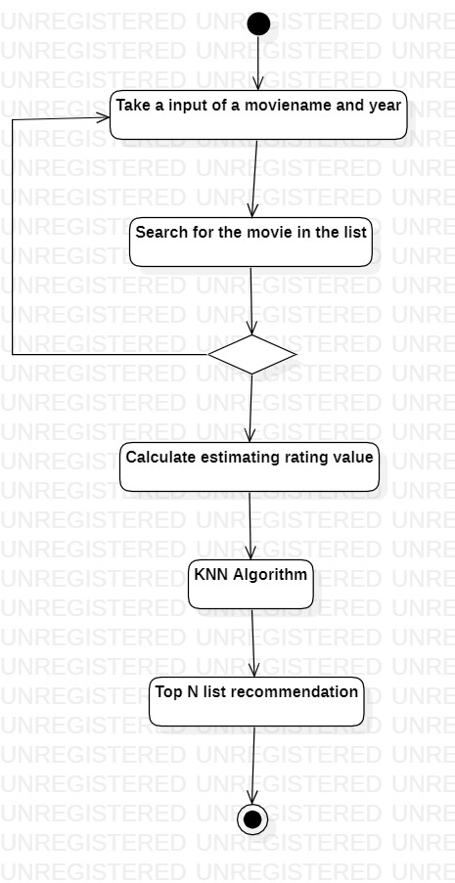
ACTIVITY DIAGRAM

Slide 16
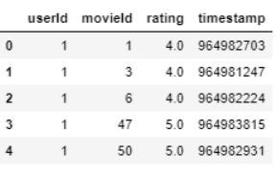
Implementation
Modules Used:
Pandas ,Numpy ,Scipy.sparse ,sklearn.neighbors ,matplotlib.pyplot
Movie Dataset:
MovieId – once the recommendation is done, we get a list of all similar movieId and get the title for each movie from this dataset.
genres – which is not required for this filtering approach.

Slide 17
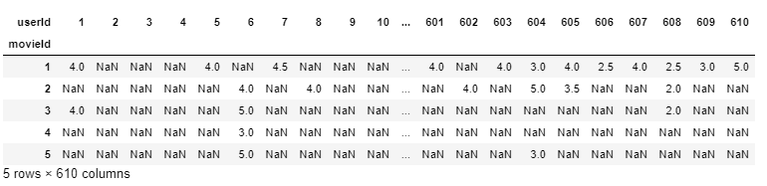
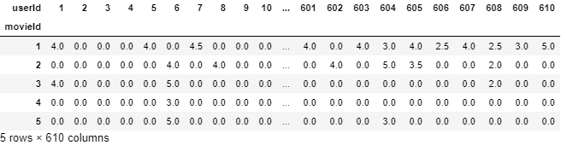
implementation
User dataset :
The dataset before removing the null values
Filling the NaN with 0.0 to male things understandable for the algorithm:

Slide 18
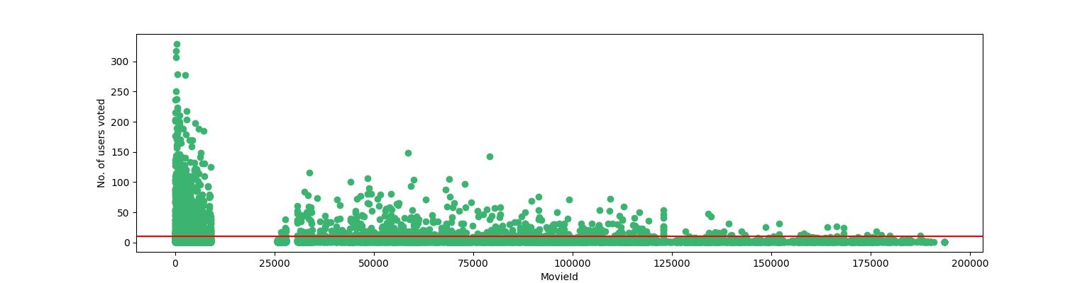
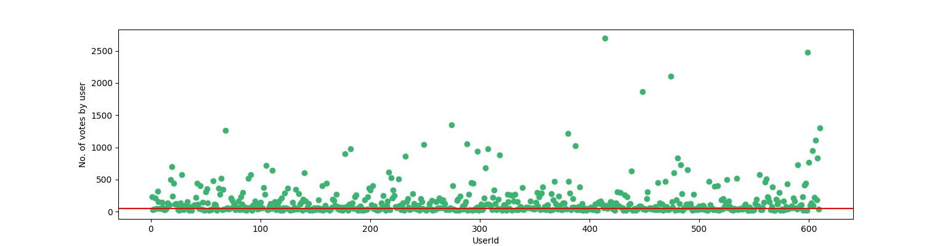
Implementation
Removing Noise from the data
To qualify a movie, a minimum of 10 users should have voted a movie.
To qualify a user, a minimum of 50 movies should have voted by the user.
Making modification as per the threshold set.

Slide 19
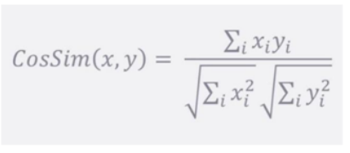
implementation
Cosine Similarity:The formula used to measure how similar the movies are based on their similarities of different properties. Mathematically, it shows the cosine of the angle of two vectors projected in a multidimensional space. The cosine similarity is very beneficial since it helps in finding similar objects.

Slide 20
IMPLEMENTATION
Removing sparsity:
To reduce the sparsity we use the csr_matrix function from scipy library.
Making the movie recommendation system model :
Using the KNN Algorithm to compute similarity with cosine distance metric which is very fast .
Recommending movies:
Gives top 5 movies as output.

Slide 21
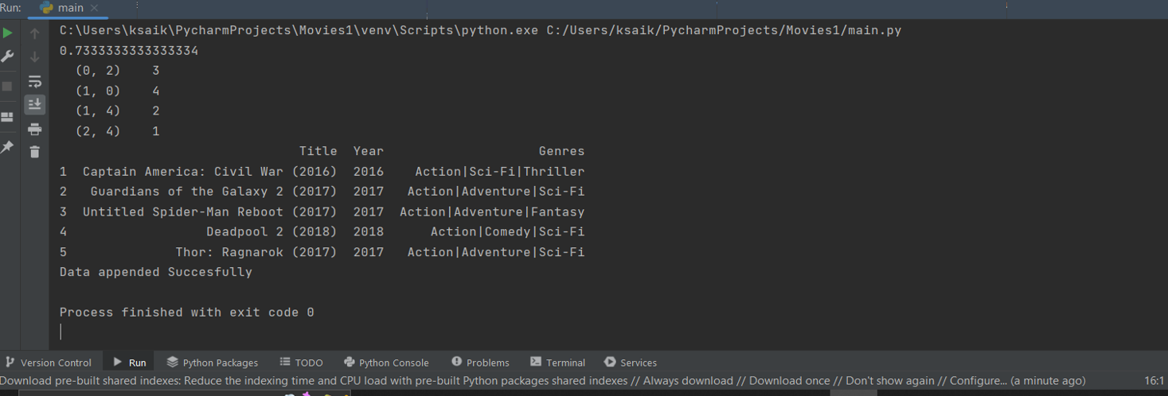
ImpLementation
Result:

Slide 22
Conclusion
We have illustrated the modelling of a movie recommendation system by making the use of collaborative-based filtering in the movie recommendation system. The KNN algorithm is implemented in this model along with the principle of cosine similarity as it gives more accuracy than the other distance metrics and the complexity is comparatively low too.

Slide 23
Reference
https://ieeexplore.ieee.org/document/6382910
Xiaoyuan Su and Taghi M. Khoshgoftaar, “A Survey of Collaborative Filtering Techniques,” Advances in Artificial Intelligence, vol. 2009, Article ID 421425, 19 pages, 2009
Cui, Bei-Bei. (2017). Design and Implementation of Movie Recommendation System Based on Knn Collaborative Filtering Algorithm. ITM Web of Conferences. 12. 04008. 10.1051/itmconf/20171204008
Marovic, M., Mihokovic, M., Miksa, M., Pribil, S., & Tus,A. “Automatic movie ratings prediction using machine learning”. In: 2011 Proceedings of the 34th International Convention MIPRO (2011,may), pp. 1640–1645.
MovieLens. MovieLens(100k). 1998. URL: http : / / grouplens . org / datasets/movielens/100k/ (visited on 05/15/2020).
Naumov, M.,and Mudigere, D. DLRM: An advanced, open source deep learning recommendation model. 2019. URL: https : / / ai . facebook . com / blog / dlrm - an - advanced - open - source - deep - learning - recommendation-model/. Accessed: 13 May 2020.
Nguyen H.V., Bai L. “Cosine Similarity Metric Learning for Face Verification”. In: Kimmel R., Klette R., Sugimoto A. (eds) Computer Vision – ACCV 2010. ACCV 2010. Lecture Notes in Computer Science, vol 6493. Springer, Berlin, Heidelberg (2011).

Slide 24
Thank You!

